Slide 1


Evaluation of Personal finance

Slide 2
Key Points
Evaluating your personal financial situation is easier than you think
Helps you create a roadmap for your financial goals
Allows you to budget smarter
Allows you to manager risk better

Slide 3
Why is it so important?
To figure out how much debt you have and to make sure you don’t accumulate more of it
What is debt and why is it bad? Well…
Debt can be defined as money raised through the issuance of bonds
It can lead to overspending
Can make it difficult to buy your dream car or house
Debt costs us more money

Slide 4
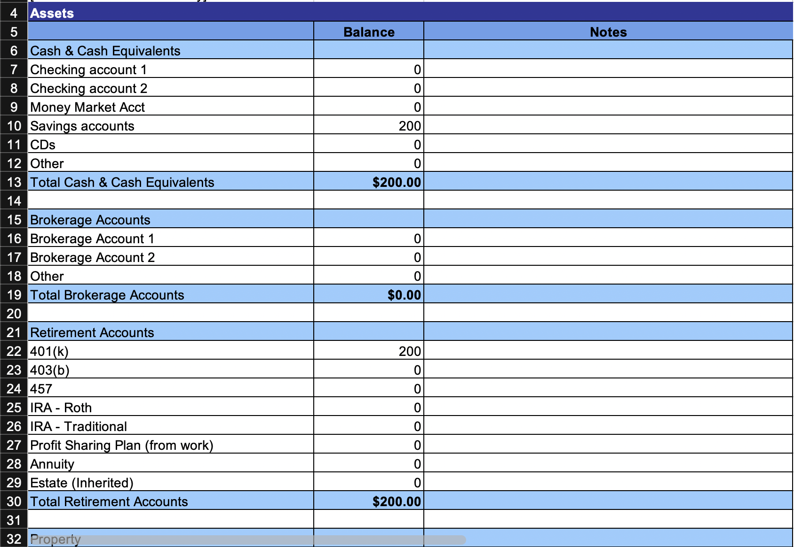

Slide 5
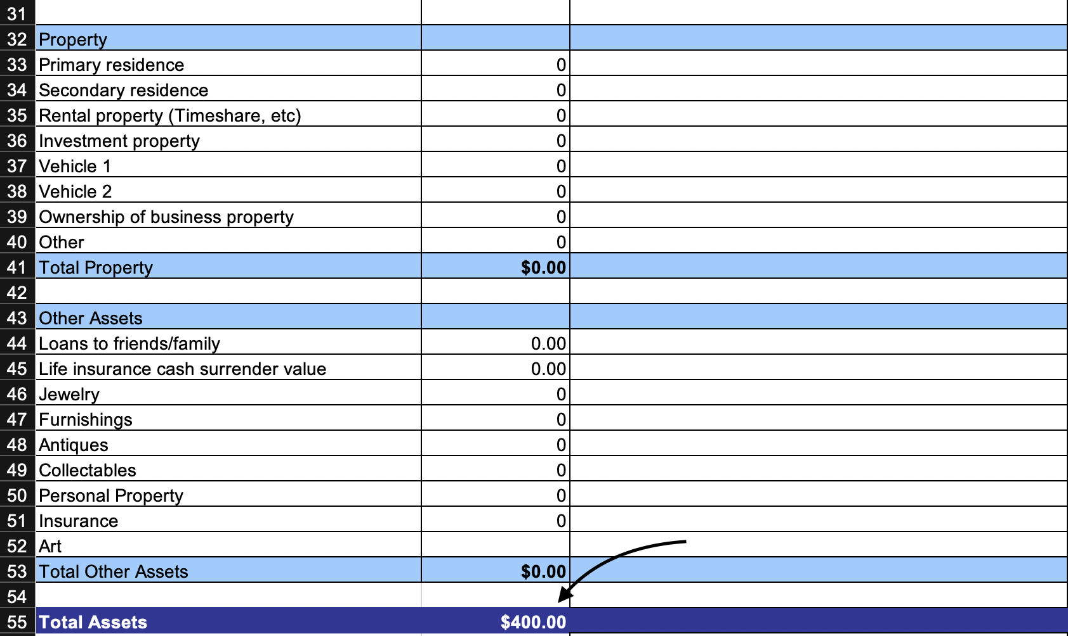

Slide 6
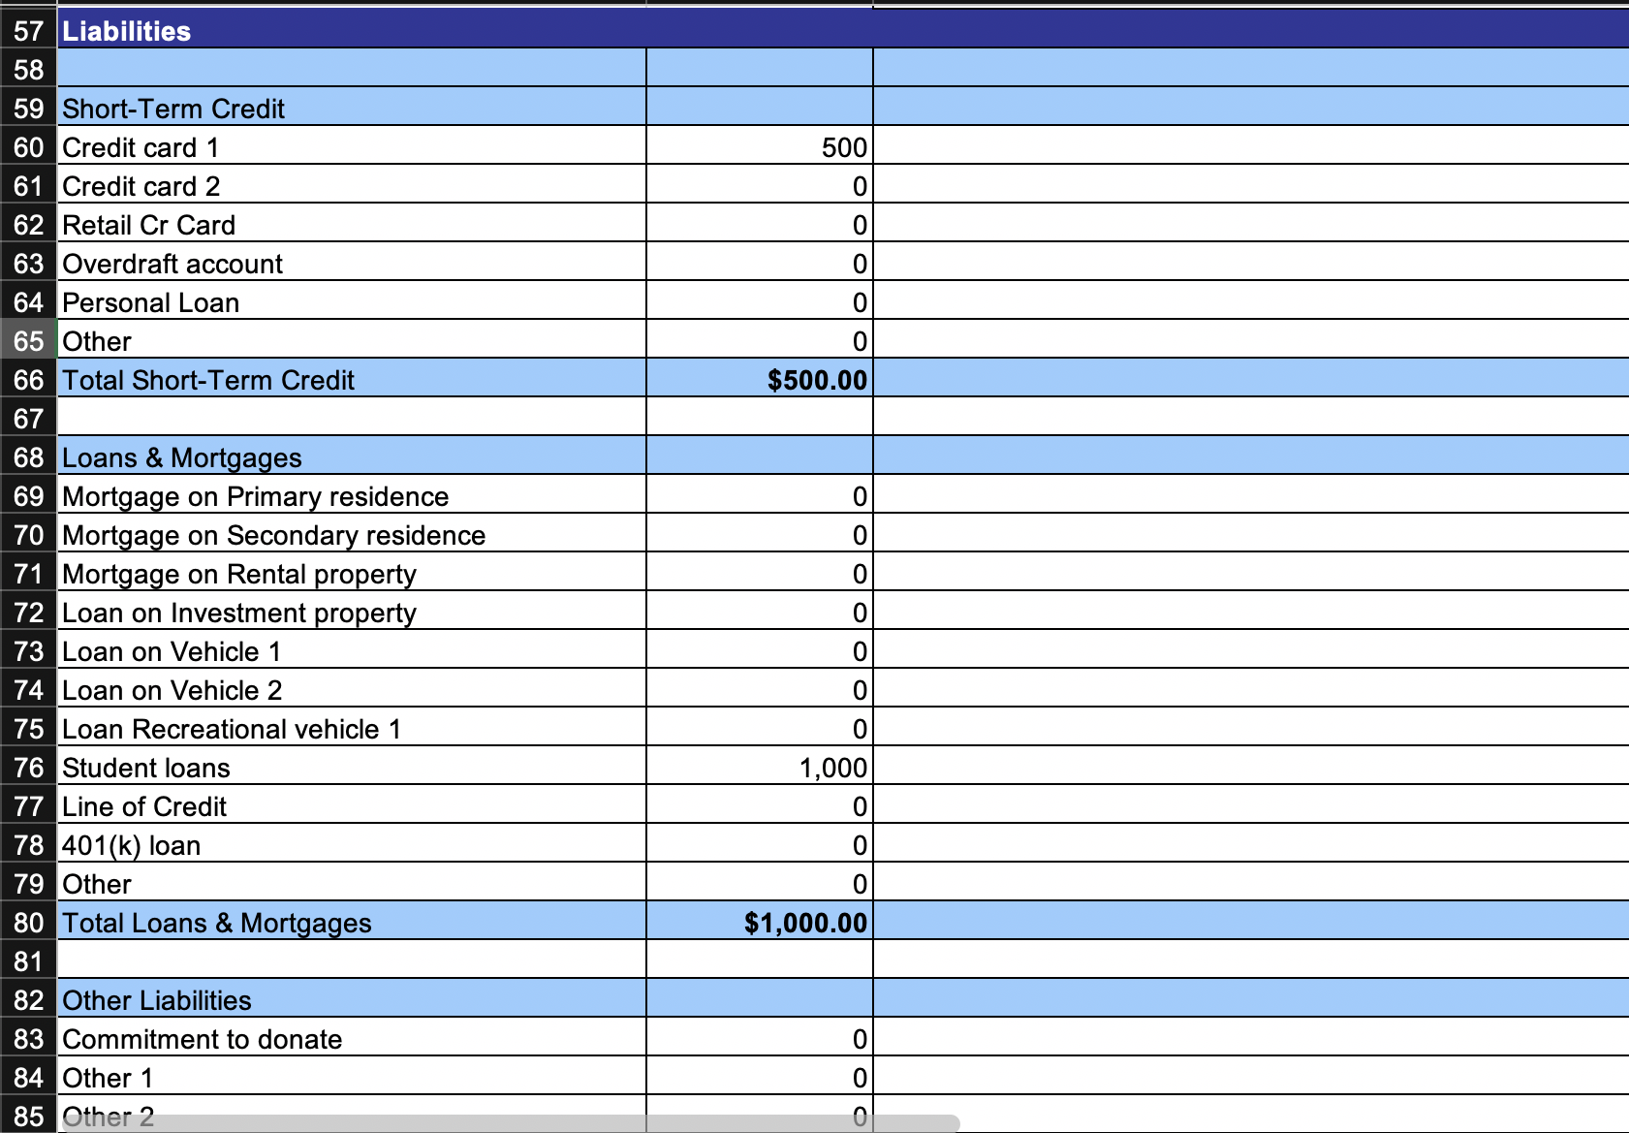

Slide 7
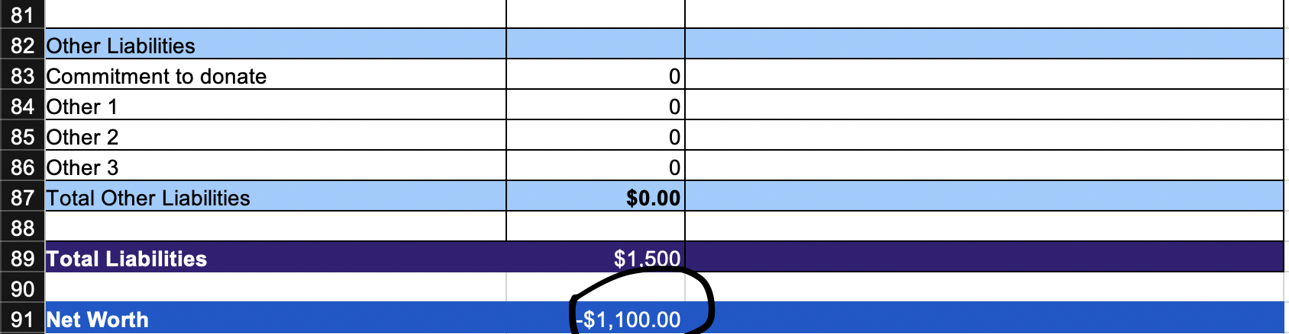
As a college student you’ll most likely have more debt than assets leading to a negative net worth
This shouldn’t be concerning since this is a point in your life where you are investing in yourself through higher education

Slide 8
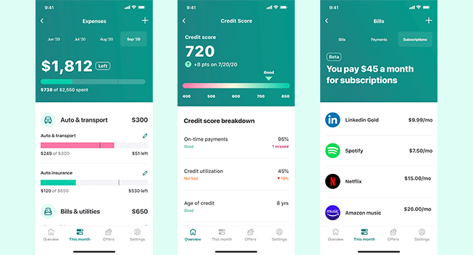
Other Ways to Evaluate your Finances
Mint Mobile by Intuit
Automates the entire process
Easy to use
Clear layout
Organized

Slide 9

Closing Remarks
It’s extremely important to understand where you stand financially
It will help you in the present and future

Slide 10
Thank You

