Slide 1
A Beginners Guide to Paying Taxes
Financial Wellness
Daniel Brannigan

Slide 2
Where do I start?
Determine what type of service you will use to file your taxes
- Accountant
- E- Services
Collect all appropriate tax documents
File by the April 15th deadline. If an extension is needed, call the IRS. (Form 4868)
File electronically or by mail.
Every month late results in a 5% fee, up to 25% in fees.
It is illegal to NOT pay your taxes.

Slide 3
Accountant or e-service
There is no wrong answer. It is based off your tax situation and personal preference.
Accountant (CPA)
Typically, more expensive
Provide real time service
Provide in – depth personal knowledge and help
Services are provided year round
Less chance for human error (taxpayer)
E- Service
Price range, free – hundreds
Basic services around $100
Simple and efficient
May be filed within an hour
Software can walk you through steps, if you have correct forms

Slide 4
What forms are needed
1099 forms: Informational return to notify the IRS of any outcome outside of W-2 earnings.
There are multiple types of 1099 forms.
W-2: Form employer sends to employee, describing wages and tax withholdings, and are sent to employees who have made at least $600 from the employer during that year.
W-2 also shows wages, tips, compensation and different tax withholdings and how much was paid to Medicare and social security
1098T: Form for students who have paid for qualified tuition and related expenses

Slide 5
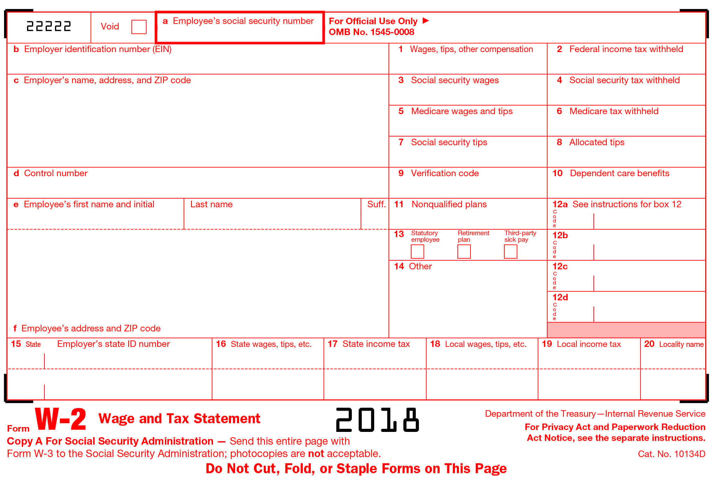
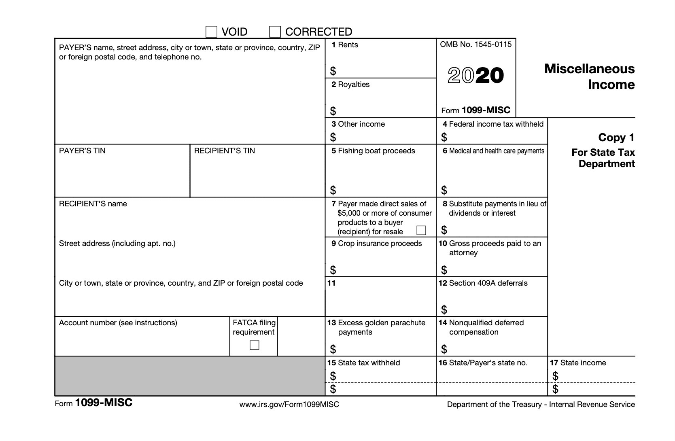

Slide 6
Different Tax Services (E-services)
Intuit: TurboTax
H&R Block
TaxSlayer
There are many more online services that can be used, but all offer the same filing services, but can offer different complimentary services.
Linked below is an article with useful software's and the different services they offer.
Forbes: Useful Tax filing Services
IRS free E-File service
IRS E-File Service

Slide 7
Thank You

